Slide 1
Technology Value Streams
<Deena Linehan>
<CSD-380>
<01/10/2025>

Slide 2
What is technology value stream?
Definition:
A technology value stream encompasses all of the activities required to deliver a product or service to a customer from initial concept through delivery.
What is the importance?
Understanding and optimizing these streams help to enhance efficiency and customer satisfaction.

Slide 3
Lead Time VS. processing time
Lead Time
The total duration from when a request is made up until it is fulfilled, including all waiting periods is the time frame referred to as the lead time.
Procession time
The processing time, is the actual time spent working on a task while excluding any of the waiting periods.

Slide 4
The common scenario: deployment lead times that require months
Challenges: Many organizations experience deployment lead times that span months due to factors like complex systems, manual testing, and multiple approval processes.
Impact: Having extended lead times can delay any feedback, reduce market responsiveness, and increase the costs of the project.

Slide 5
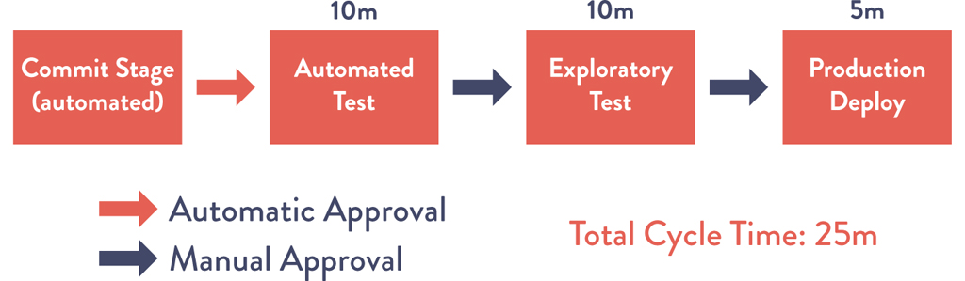
Our devops Ideal: deployment lead times of minutes
Goal: Achieving deployment lead times measured in minutes through automation, continuous integration, and continuous delivery practices.
Benefits: Faster feedback loops, improved product quality, and enhanced customer satisfaction.

Slide 6
How to transition from Months to minutes
Implement automated testing and deployment pipelines.
Adopt modular and loosely coupled architectures.
Foster a culture of continuous improvement and collaboration.

Slide 7
Value Stream in software development
Definition:
Viewing features as a continuous flow from idea to customer delivery, emphasizing value creation at each step.
Components:
Value Creation: Developing the product or feature.
Value Delivery: Getting the product to the customer.
Value Capture: Monetizing the delivered product.

Slide 8
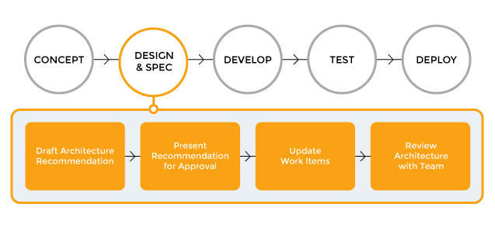
Visualizing the Value Stream

Slide 9
Improving the Value Stream
Identifying and eliminating bottlenecks.
Enhancing process efficiency through continuous monitoring and feedback.
Leveraging tools and platforms for value stream management.

Slide 10
Sources
Value Streams in Software: A Definition and Detailed Guide
What is Lead Time in Value Stream Mapping? | Miro
4 Key DevOps Metrics to Know | Atlassian
“The DevOps Handbook” by Gene Kim, Patrick Debois, John Willis, and Jez Humble.

